Slide 1
REDUCING THE WORKLOAD
TIM TAYLOR AND JOSH NEEDHAM

Slide 2
What is Big Data

Slide 3
HADOOP ORiGINS
Dough Cutting created the framework to process large data
He named it after his sons toy Elephant
Originally wanted to build something to compete with Google

Slide 4
What is Hadoop?
Hadoop is a collection of software utilities that facilitate using a network of many computers to solve problems involving massive amounts of data and computation
Data Growth is EXTREMELY HIGH right now and doesn’t show signs of slowing
Can handle large data sets (25 petabytes of data)
Uses Java based programming to distribute processing large datasets across large networks of computers (4500 machines)
Easily scalable and highly fault tolerant
Open Source

Slide 5
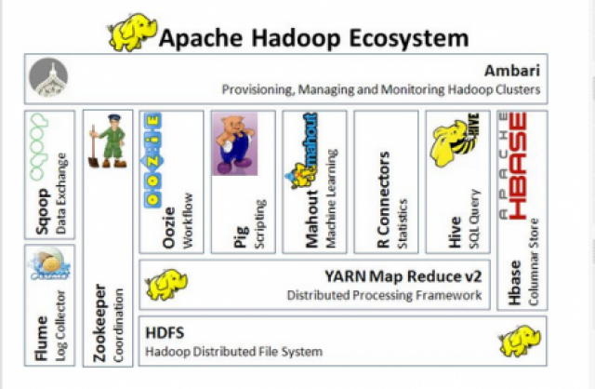
Hadoop Ecosystem
Hadoop is a collection of different utilities that work together. How these are structured can be customized to the needs of the users.
HDFS
MAPREDUCE
PIG
HIVE
ZOOKEEPER
HBASE
And many more…

Slide 6
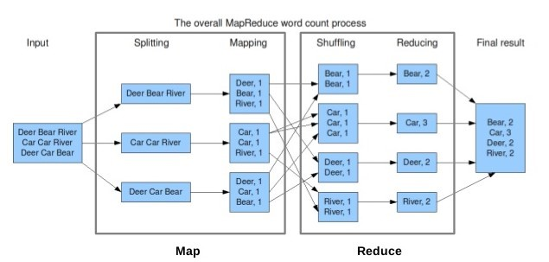
MAP REDUCE
This is the processing part of the system
Manages the job sharing
Generally called the Task Tracker

Slide 7
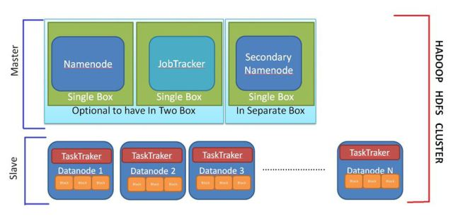
HDFS (Hadoop Distributed file system)
Where the DATA is stored (Generally called the Data node)
Each node in the Hadoop network will have a HDFS
The Job Tracker keeps track of all the nodes

Slide 8
Job Tracker
One job tracker regardless of the size of the system
Accepts the users jobs and assigns work to each node
In charge of adjusting if one of the nodes goes out

Slide 9
NAMENODE
One Name Node regardless of the size of the system
Secondary Name Node is a backup in case the Name node crashes
Data never flows between nodes or up to the master

Slide 10
PIG
High level scripting language
Like a compiler, but specifically for MapReduce
Converts simpler code into Map Reduce

Slide 11
HIVE
Similar to PIG
For users that are not code savvy
Hive emulates SQL so more people can use Hadoop with less code knowledge or Hadoop experience

Slide 12
What are the differences between Hadoop and sql?

Slide 13
HBase
Provides some Real-Time database functionality
Traditionally without HBASE Hadoop is generally more batch processing centered
Accessible directly through PIG, HIVE, AND MAPREDUCE
HBASE is used for Facebook messenger currently

Slide 14
zookeeper
Only used when Data needs exceed the maximum of Hadoop
Zookeeper allows multiple Master server to communicate with each other

Slide 15
Implementation difficulties
Hadoop is a collection of software utilities
How do I decide what to use?
Seems like a lot of steps and training
Do I have to use all of them?
How much will it cost?
Are my data needs big enough to make this worth it.
Will this save me money as my business grows?

Slide 16
SCALABILITY

Slide 17
THANKS FOR LISTENING

Slide 18
SOURCES
https://hadoop.apache.org/
"Hadoop Fair Scheduler Design Document" (PDF). apache.org
Pessach, Yaniv (2013). "Distributed Storage" (Distributed Storage: Concepts, Algorithms, and Implementations ed.). Amazon.com
"The Apache Software Foundation Announces Apache™ Spark™ as a Top-Level Project : The Apache Software Foundation Blog"
Cutting, Mike; Cafarella, Ben; Lorica, Doug (2016-03-31). "The next 10 years of Apache Hadoop". O'Reilly Media
Dean, Jeffrey; Ghemawat, Sanjay. "MapReduce: Simplified Data Processing on Large Clusters".
Judge, Peter (2012-10-22). "Doug Cutting: Big Data Is No Bubble". silicon.co.uk.
"What is the Hadoop Distributed File System (HDFS)?". ibm.com. IBM. Retrieved 2014-10-30.
Hemsoth, Nicole (2014-10-15). "Cray Launches Hadoop into HPC Airspace". hpcwire.com.
Google Research Publication: The Google File System".
"Cloud analytics: Do we really need to reinvent the storage stack?" (PDF). IBM. June 2009.
Defining Hadoop Compatibility: revisited". Mail-archives.apache.org. 2011-05-10.
"Winning a 60 Second Dash with a Yellow Elephant" (PDF). Sortbenchmark.org.
"From Spiders to Elephants: The History of Hadoop".
https://www.facebook.com/notes/facebook-engineering/the-underlying-technology-of-messages/454991608919/

